Slide 1
Linear Regression
DATA SCIENCE

Slide 2
Agenda
A basic univariate linear regression model (OLS)
Loss functions and how to calculate the coefficients
Extending the model to multiple features
Using scikit-learn to generate a regression model
Notes:
These workshop objectives should match the learning objectives of the curriculum topics being covered.
Checkpoints should be linked.

Slide 3
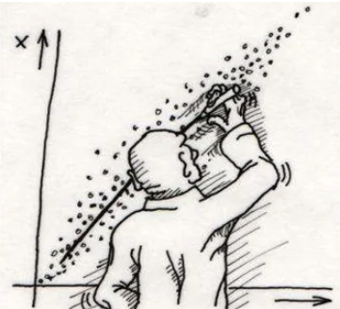
Warm Up
How does the ROC curve differ in binary and multi-class classification?

Slide 4

Linear Models
UP NEXT
Notes:
You can vary the image above from the image bank

Slide 5

Why Do We Use Prediction Models?
One of the simplest relationships that we can model is the linear relationship
A linear relationship means that for every change in our independent variable, we will see a proportional change in the dependent variable
This type of relationship can be observed in many areas like economics and agriculture
Notes:
Linear relationships are one of the most fundamental relationships between variables that we can observe in a dataset

Slide 6
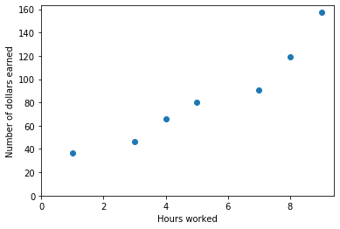
A Simple Linear Regression Model
Assume we are a business owner and we want to build a model to predict weekly employee pay
This example makes more sense if you imagine a line of work where pay has some variability to it – waiters and waitresses, salespeople working on commission, etc.
Our only feature (for now) is the number of hours worked by the employee
How could we attempt to model this relationship?
Notes:
Linear relationships are one of the most fundamental relationships between variables that we can observe in a dataset

Slide 7


A Simple Linear Regression Model
A simple approach would be to assume a linear relationship between our feature and response, plus some variation that is not captured by the model (hopefully uninformative “noise”)
Mathematically, this can be expressed as follows:
However, there are many different lines we can fit to this data; how do we decide which is best?
Notes:
Linear relationships are one of the most fundamental relationships between variables that we can observe in a dataset

Slide 8
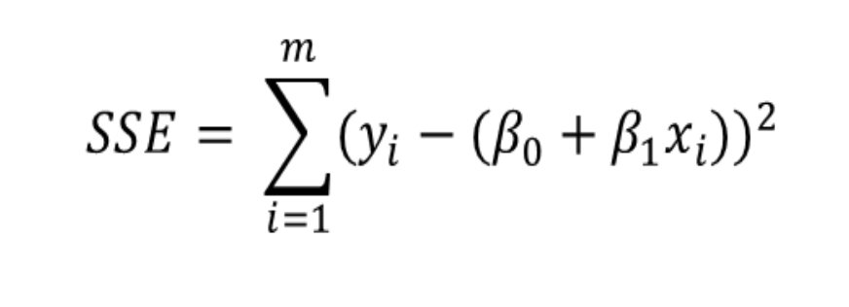
Loss Function
Our goal is to create a model that has the most optimal coefficients; “optimal" is defined by our loss function, a formula that quantifies how "bad" each predication is
Commonly used loss functions follow certain intuitive rules, such as "a perfect prediction should result in a loss of zero"
The most common loss function in linear regression is SSE (Sum of Squared Errors):
Actual
Predicted

Slide 9
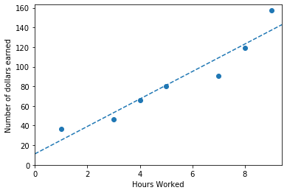

Loss Function
Feature Value | Predicted | Actual | Error | Squared Error
1 | 25.1 | 36.7 | 11.6 | 134.6
3 | 53.1 | 46.3 | -6.8 | 46.2
4 | 67.2 | 65.7 | -1.5 | 2.3
5 | 81.2 | 80.4 | -0.8 | 0.6
7 | 109.2 | 90.9 | -18.3 | 334.9
8 | 123.2 | 118.8 | -4.4 | 19.4
9 | 137.3 | 157.1 | 20.2 | 408.0
Total SSE: 946
Notes:
The red lines in the right hand diagram indicate the errors; we square the lengths of those lines to get the squared error for each observation.

Slide 10
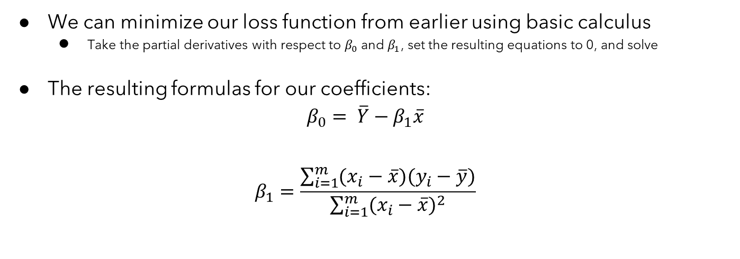
Loss Function
Notes:
The formula for B1 contains several useful links to other statistical concepts. An equivalent formulation would be Cov(X,Y) / Var(X).

Slide 11
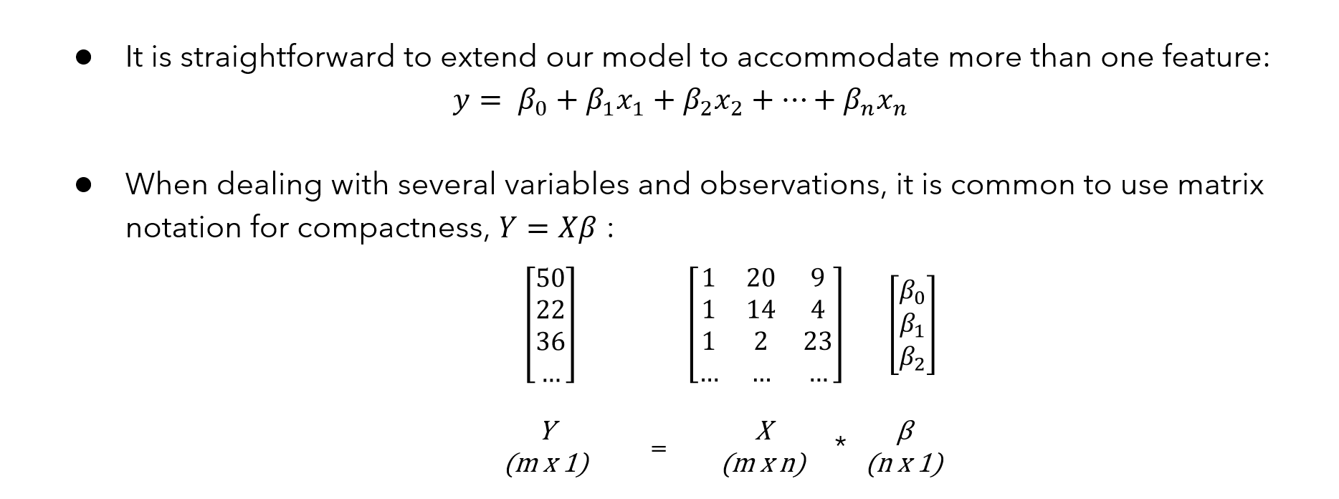
Multivariate Linear Regression
Notes:
For X with m observations and n coefficients (n-1 features). This is a good spot to point out how B0 is implemented in practice: by adding a column of all 1s, a new “feature” that is constant. Functions like sm.add_constant() from statsmodels do exactly this when the user wants an intercept term in their model.
Finally, this is a good point to call out that we are no longer fitting a line in higher dimensions, but a plane (or more generally, a hyperplane).

Slide 12
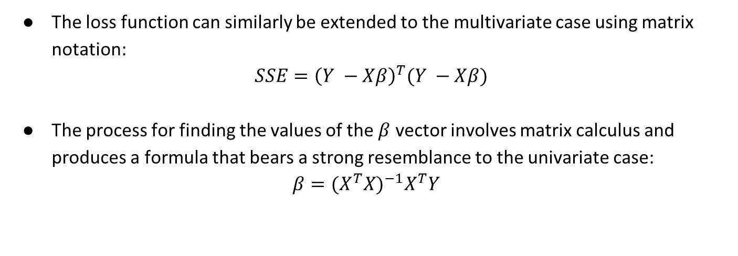
Multivariate Linear Regression
Notes:
The formula for the B coefficients is very famous, and there are numerous resources online that walk through the derivation.

Slide 13
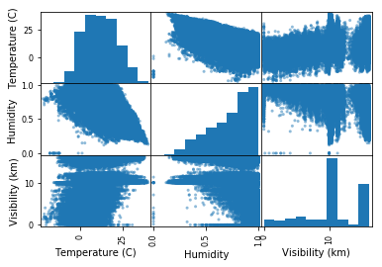
Example
In this example we will observe the weather data from Szeged in Hungary between 2006 and 2016
We will attempt to find the relationship between temperature, humidity, and visibility

Slide 14
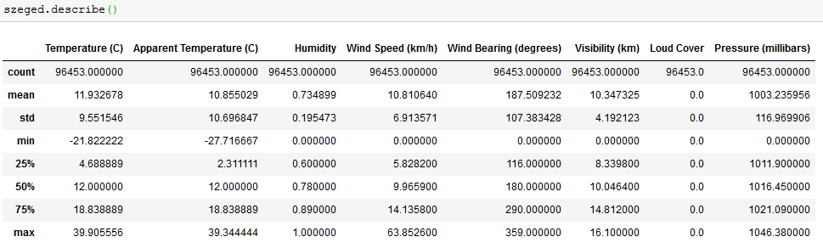
Exploratory Data Analysis
We will start by loading and describing the dataset

Slide 15
Plotting the Chosen Columns
We will plot humidity and visibility against temperature to identify a linear relationship
Notes:
Uses seaborn pairplot or similar
Note that along the diagonal we have the histogram of each column

Slide 16
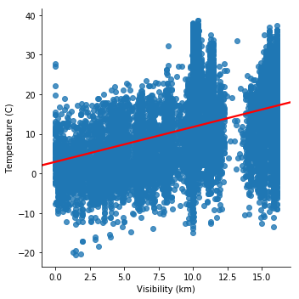
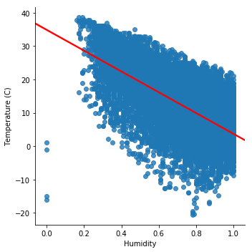
Modeling The Data
Now we produce the linear model using scikit-learn
We will then plot our resulting linear regression equation

Slide 17
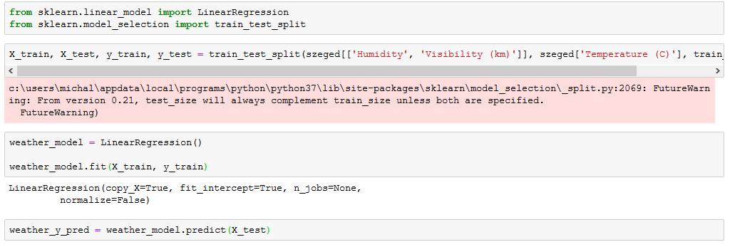
Our Code

Slide 18
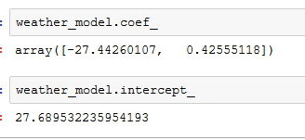
Our Model
We can use this model to extract our regression equation
There are separate attributes for the coefficients and the intercept

Slide 19
Summary
We learned about the importance of linear regression
We examined the regression equation and how to calculate the coefficients
We looked at an example of a regression equation in scikit-learn
Notes:
These workshop objectives should match the learning objectives of the curriculum topics being covered.
Checkpoints should be linked.

Slide 20
Assignment Slide
Assignment
In your pairs, work through the following assignment, using linear regression to model the antioxidant quality of lagers.
Jupyter Notebook

Slide 21
Thank You

